Slide 1
Protecting Your PC or Laptop
Malware, Spam and Spyware

Slide 2
Definition of a Computer Virus
A computer virus is a malicious software program designed to do damage to your computer system by deleting files or even taking over your computer to launch attacks on other systems.

Slide 3
Tip
Many computer attacks today are executed using computers compromised by a computer virus.

Slide 4
Signs of an Infection
You might see strange messages or graphics displayed on your computer screen or find that normally operated programs are acting erratically.
You might notice that files have gone missing
Your computer is sluggish or slow
Computer might fail to start up

Slide 5
Catching a Virus
There are many ways you can share data and transmit a virus online
Opening an infected file attached to an email message
Launching an infected program file downloaded from the internet
Sharing a USB memory drive or data CD that contains an infected file

Slide 6
Tip
Whenever you open a file attached to an email or instant message, you stand a good chance of infecting your computer

Slide 7
Don’t be a victim

Slide 8
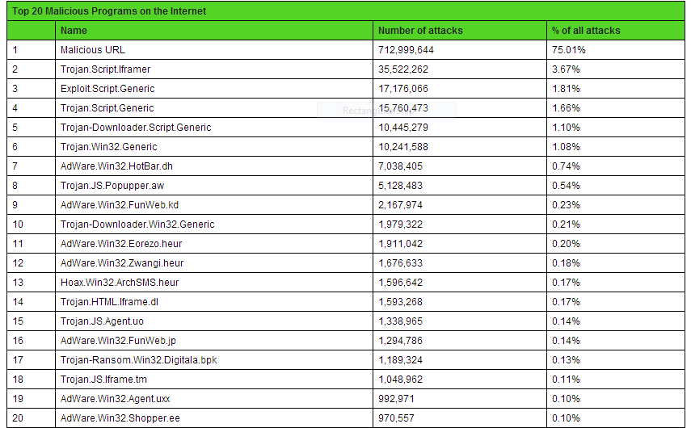
Top 20 Malicious Programs

Slide 9
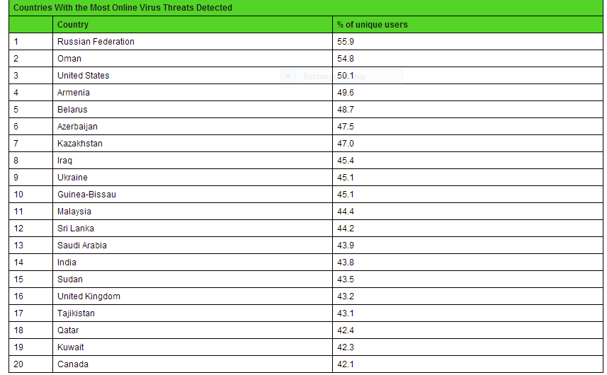
Countries with the most virus threats

Slide 10
Virus problems call us

